Slide 1
Priority of operations with positive integers
Arithmetic procedures with integers and decimals

Slide 2
how to use Oak lessons

Slide 3
I can calculate using priority of operations, including brackets, powers and exponents with positive integers.

Slide 4
In mathematics, an operation is a function which takes an input value to an output value. Addition, subtraction, multiplication, division, roots and powers and many more are examples of operations.
The additive inverse of a number is a number that, when added to the original number, gives the sum of 0.
An operation is commutative if the values it is operating on can be written in either order without changing the calculation.

Slide 5

Priority of operations with positive integers
Multiplication, division, addition and subtraction
Brackets, roots and exponents

Slide 6

Multiplication, division, addition and subtraction
The priority of operations is important as it ensures that everyone can understand and approach a mathematical problem the same way.
( …. )
⬚
⬚
⬚
× ÷
+ −

Slide 7
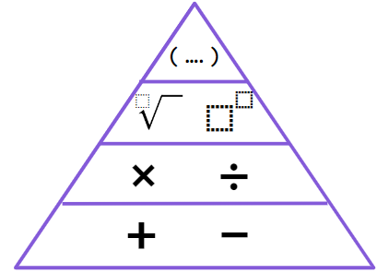
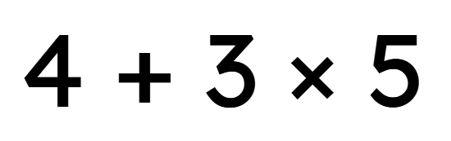
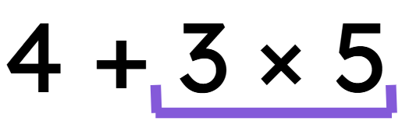
Multiplication, division, addition and subtraction
The priority of operations is important as it ensures that everyone can understand and approach a mathematical problem the same way.
Here we have 4 + 3 × 5
Using the priority of operations, which operation do we apply first?
4 + 15
= 19

Slide 8

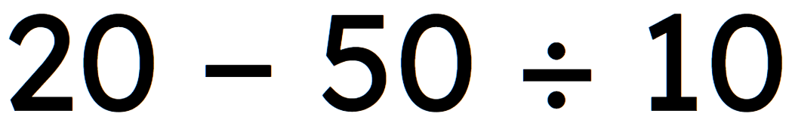
Multiplication, division, addition and subtraction
The priority of operations is important as it ensures that everyone can understand and approach a mathematical problem the same way.
Here we have 20 − 50 ÷ 10
Using the priority of operations, which operation do we apply first?
20 − 5
= 15

Slide 9
Multiplication, division, addition and subtraction
What do you think happens when we have two of the same operation?
Example
Here we have 12 ÷ 2 + 20 ÷ 4
We do both of the same operation at the same time.
12 ÷ 2 + 20 ÷ 4
6
+
5
= 11

Slide 10
Multiplication, division, addition and subtraction
What do you think we do when we have two operations on the same row?
For addition and subtraction, using subtraction as the addition of the additive inverse allows every operation to be addition.
Here we have 20 + 16 − 4
20 + 16 + (-4)
= 32

Slide 11
Multiplication, division, addition and subtraction
What do you think we do when we have two operations on the same row?
Here we have 12 × 20 ÷ 4
They both have the same priority.
12 × 20 ÷ 4
12 × 20 ÷ 4
240 ÷ 4
= 60
12 × 5
= 60
As they have the same priority, we do either operation first.

Slide 12

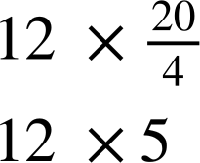

Multiplication, division, addition and subtraction
What do you think we do when we have two operations on the same row?
A better approach is to write the division as a fraction …
Here we have
as it makes the divisor clear and reduces errors.

Slide 13




Multiplication, division, addition and subtraction
Aisha and Jacob are given this calculation
10 − 6 + 4
Who is correct?
Knowing subtraction is adding
the additive inverse
10 + (-6) + 4
So I can do this in any order
10 + 4 + (-6)
14 + (-6) = 8
10 subtract 6 is 4, then 4 add 4 is 8
Aisha
Jacob

Slide 14

Multiplication, division, addition and subtraction
Aisha and Jacob are given this calculation
10 − 6 + 4
Both are correct! Either can be applied to work out the correct answer. Using additive inverses means we can use the commutative property of addition.
Knowing subtraction is adding the additive inverse
10 + (-6) + 4
So I can do this in any order
10 + 4 + (-6)
14 + (-6) = 8
10 subtract 6 is 4, then 4 add 4 is 8
Aisha
Jacob

Slide 15

Multiplication, division, addition and subtraction
Laura looks at the calculation and says the answer is 0
10 − 6 + 4
Can you explain why she is wrong?
She has interpreted the 6 to be a positive 6, when the calculation is the addition of -6
10 − 6 + 4 = 10 + (-6)+ 4
Addition comes before subtraction. You do 6 + 4 = 10, so you can think of this as 10 − 10.
Laura

Slide 16
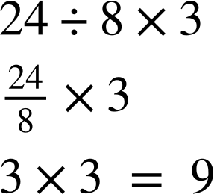
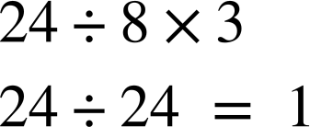


Multiplication, division, addition and subtraction
Izzy and Alex do the same calculation, but in different ways.
Who is correct? What should they have done differently?
Izzy
Alex
Alex is correct. Izzy should have written 24 ÷ 8 as a fraction and calculated this to then multiply by it 3.

Slide 17
Multiplication, division, addition and subtraction
Work out the answers to the following. Ensure to show all your working out.
12 + 6 × 2
100 − 20 ÷ 5
3 × 10 − 24 ÷ 8

Slide 18
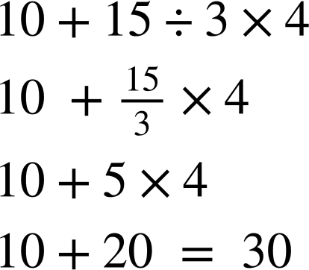
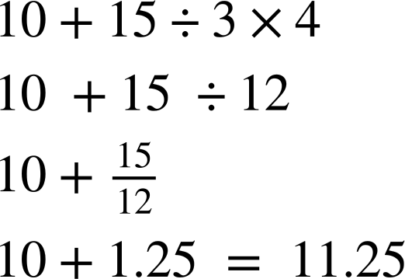
Multiplication, division, addition and subtraction
2) Sam and Sofia do the same calculation differently. Who is correct? Explain what the incorrect person should have done differently.
Sam
Sofia

Slide 19
Multiplication, division, addition and subtraction
3) Fill in the gaps with +, −, ÷ and × so that the calculations are correct.
a) 4 ⬚ 5 ⬚ 6 ⬚ 7 = 12
b) 4 ⬚ 5 ⬚ 6 ⬚ 7 = 8
c) 4 ⬚ 5 ⬚ 6 ⬚ 7 = 62
d) 4 ⬚ 5 ⬚ 6 ⬚ 7 = 7
e) 4 ⬚ 5 ⬚ 6 ⬚ 7 = 21

Slide 20
Multiplication, division, addition and subtraction
4) Fill in the gaps with +, −, ÷ and × so that the calculations are correct.
a) 10 ⬚ 2 ⬚ 2 ⬚ 3 = 8
b) 10 ⬚ 2 ⬚ 15 ⬚ 3 = 10
c) 10 ⬚ 2 ⬚ 10 ⬚ 2 ⬚ 2 ⬚ 3 = 21

Slide 21
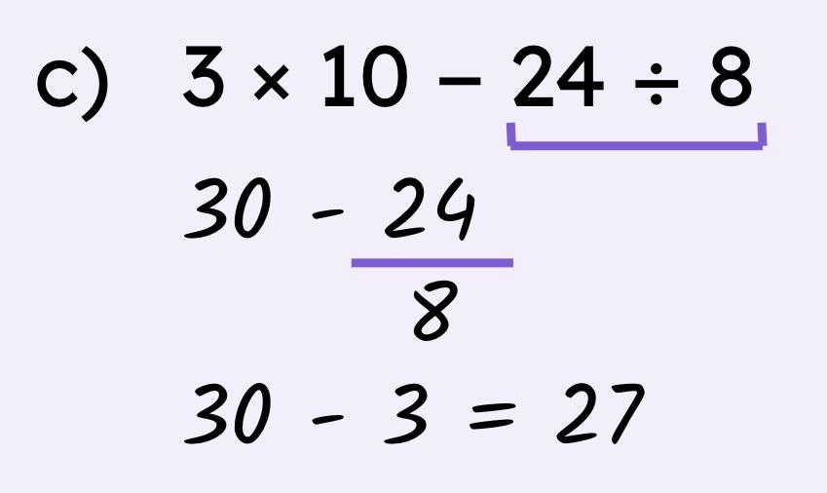
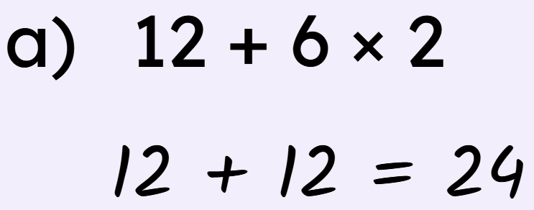
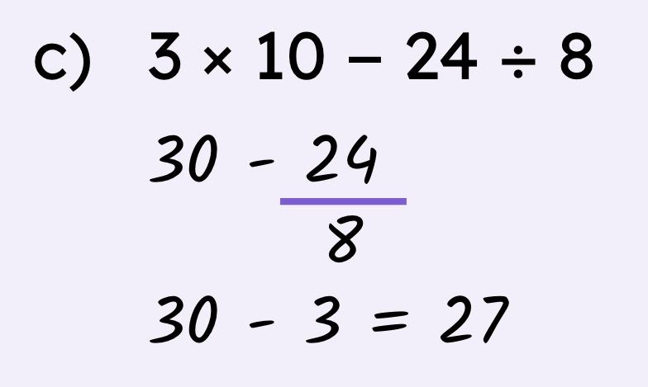
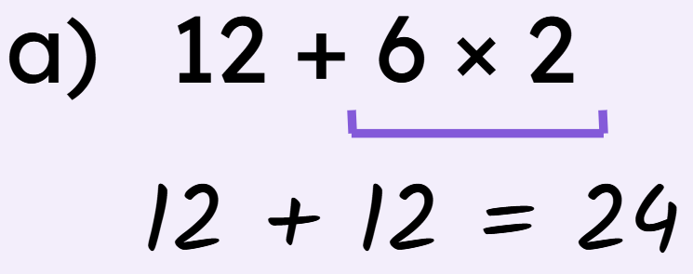
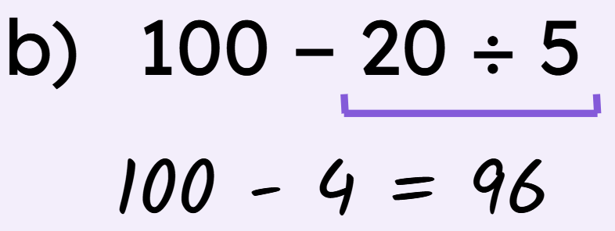
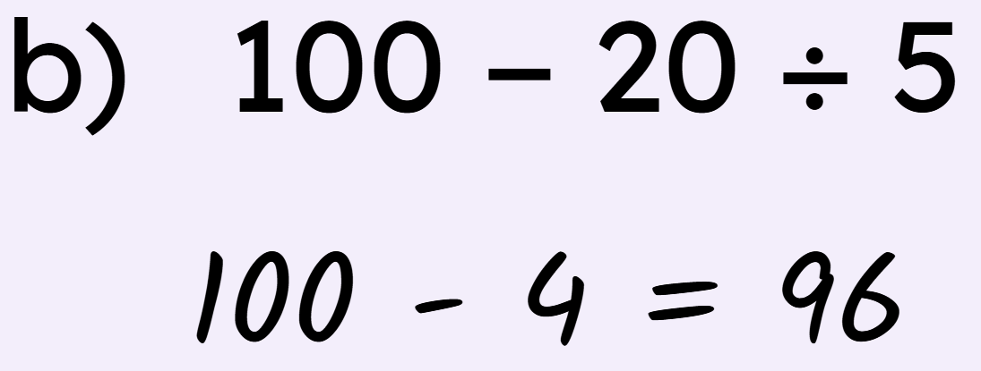
Multiplication, division, addition and subtraction
Work out the answers to the following. Ensure to show all your working out.

Slide 22
Multiplication, division, addition and subtraction
2) Sam and Sofia do the same calculation differently. Who is correct? Explain what the incorrect person should have done differently.
Sam
Sofia
Sofia should have written 15 ÷ 3 as a fraction, then multiplied by 4.

Slide 23

Multiplication, division, addition and subtraction
3) Fill in the gaps with +, −, ÷ and × so that the calculations are correct.
a) 4 – 5 + 6 + 7 = 12
b) 4 + 5 + 6 – 7 = 8
c) 4 × 5 + 6 × 7 = 62
d) 4 × 5 – 6 – 7 = 7
e) 4 × 5 – 6 + 7 = 21

Slide 24
Multiplication, division, addition and subtraction
4) Fill in the gaps with +, −, ÷ and × so that the calculations are correct.
a) 10 + 2 ÷ 2 - 3 = 8
b) 10 ÷ 2 + 15 ÷ 3 = 10
c) 10 × 2 - 10 ÷ 2 + 2 × 3 = 21

Slide 25
Priority of operations with positive integers
Multiplication, division, addition and subtraction
Brackets, roots and exponents

Slide 26
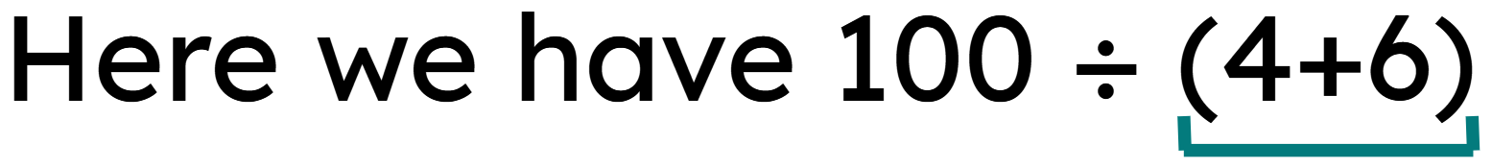
Brackets, roots and exponents
The use of brackets groups numbers together and affects the priority of operations. We do the brackets first.
( …. )
Example
Here we have 100 ÷ (4+6)
⬚
⬚
⬚
100 ÷
10
= 10
× ÷
+ −

Slide 27
Brackets, roots and exponents
After brackets, the next operations are roots and powers. This will require previous knowledge of square and cube roots and evaluating using exponents.
( …. )
Example
Here we have 12 + (4+6) × 5²
⬚
⬚
⬚
What is the first step?
× ÷
+ −

Slide 28
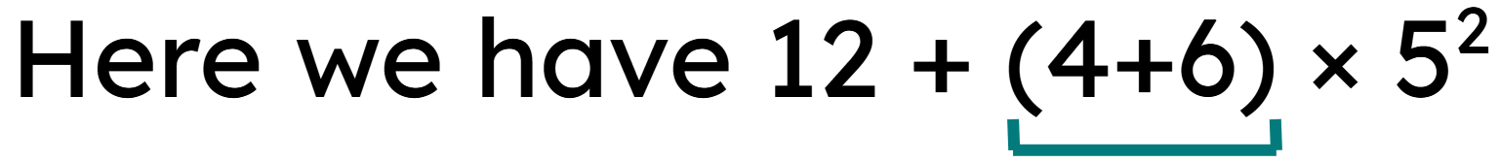
Brackets, roots and exponents
After brackets, the next operations are roots and powers. This will require previous knowledge of square and cube roots and evaluating using exponents.
( …. )
Example
⬚
⬚
⬚
12 +
10
× 5²
× ÷
+ −
What are the next steps?

Slide 29
Brackets, roots and exponents
After brackets, the next operations are roots and powers. This will require previous knowledge of square and cube roots and evaluating using exponents.
( …. )
Example
⬚
⬚
⬚
12 +
10
× 5²
× ÷
12 +
10
× 25
+ −
12 +
250
= 262

Slide 30
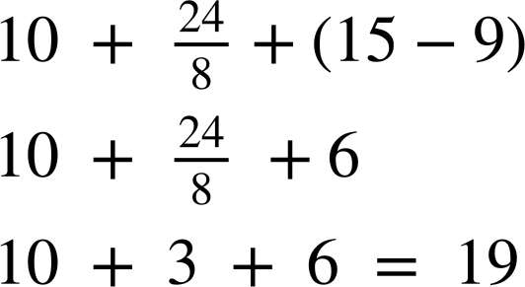
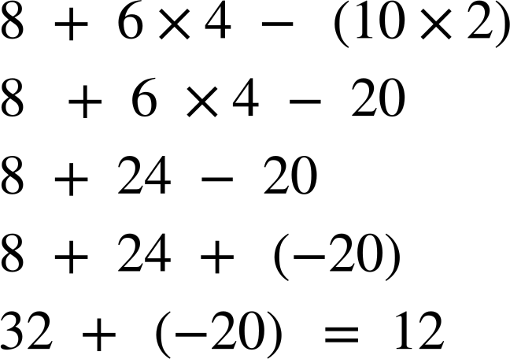

Brackets, roots and exponents
Work out the answers, showing all your working out.
a)
b)

Slide 31




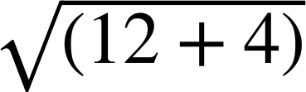
Brackets, roots and exponents
The use of brackets groups numbers together and affects the priority of operations.
Sometimes the brackets can be invisible or implicit.
Example
Example
The continuation of the line indicates the implicit brackets.

Slide 32
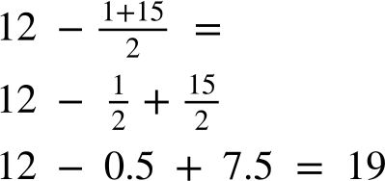

Brackets, roots and exponents
Jun did some working out.
Jun
Here we have implicit brackets.
He should have grouped the 1 and 15 first and subtracted the result from 12.
Where did he make the mistake?
What should he have done?

Slide 33
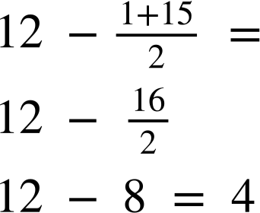
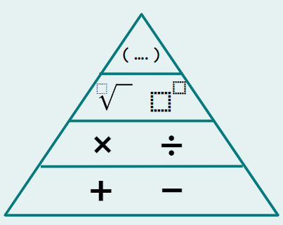

Brackets, roots and exponents
The correct working out
Implicit brackets

Slide 34
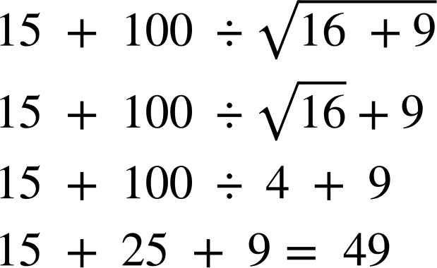

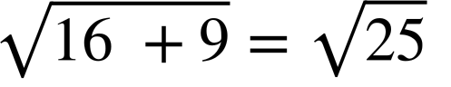
Brackets, roots and exponents
Andeep was given a different question and did some working out.
Andeep
Here we have implicit brackets.
He should have grouped the 16 and 9 first because
Where did he make the mistake?
What should he have done? Can you work out the correct answer?

Slide 35
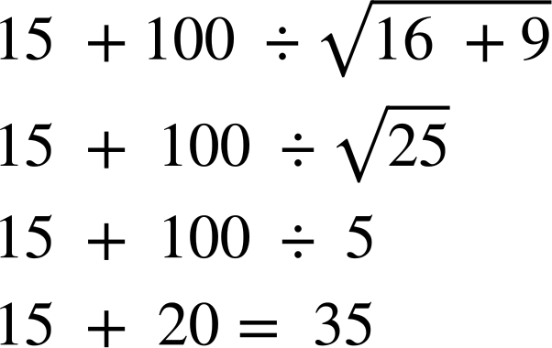
Brackets, roots and exponents
The correct working out
Implicit brackets

Slide 36
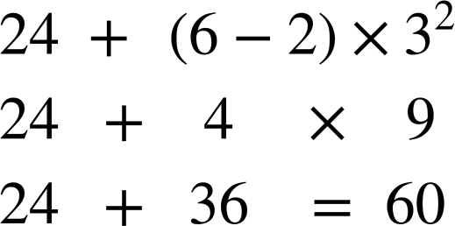
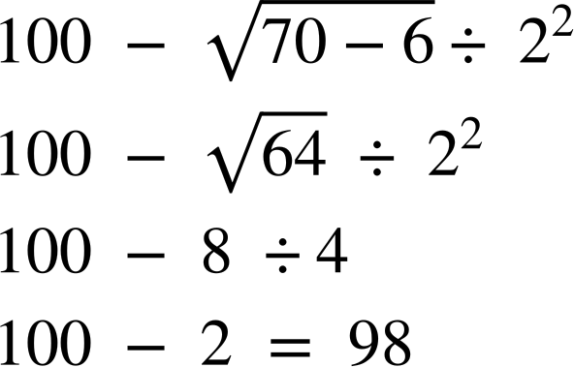
Brackets, roots and exponents
Work out the answers to the following. Ensure you show your working out.
b)

Slide 37
Brackets, roots and exponents
2) Fill in the gaps with +, −, ÷, × and brackets so that the calculations are correct. You can use more than one pair of brackets.
a) 4 5 6 7 = 117
b) 4 5 6 7 = 308
c) 4 5 6 7 = 69
d) 4 5 6 7 = 1

Slide 38
Brackets, roots and exponents
3) Use exactly four 4s, together with any of the operations ×, ÷, +, √, −, exponents (can be any value) and/or brackets to write calculations giving answers of: 1, then 2, then 3… up to 20. As an example, 8 has been done for you.
1 =
2 =
3 =
4 =
5 =
6 =
7 =
8 = 4 ÷ 4 × 4 + 4
9 =
10 =
11 =
12 =
13 =
14 =
15 =
16 =
17 =
18 =
19 =
20 =

Slide 39
Brackets, roots and exponents
Work out the answers to the following. Ensure you show your working out.
b)

Slide 40
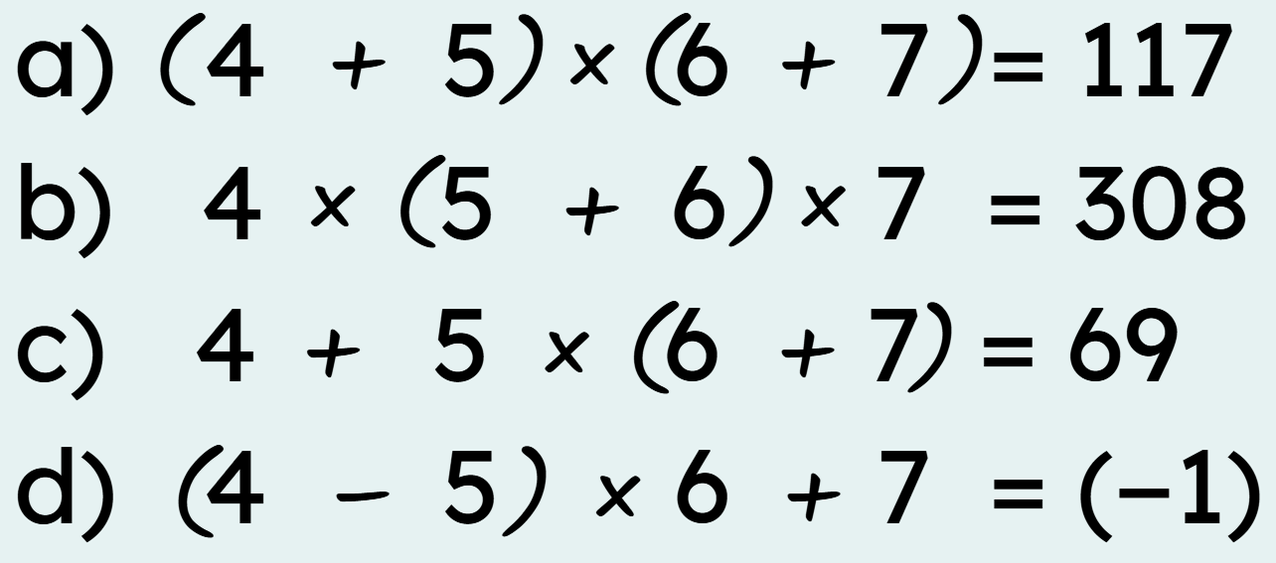
Brackets, roots and exponents
2) Fill in the gaps with +, −, ÷, × and brackets so that the calculations are correct. You can use more than one pair of brackets.
a) 4 5 6 7 = 117
b) 4 5 6 7 = 308
c) 4 5 6 7 = 69
d) 4 5 6 7 = 1

Slide 41
Brackets, roots and exponents
3) Use exactly four 4s, together with any of the operations ×, ÷, +, √, −, exponents (can be any value) and/or brackets to write calculations giving answers of: 1, then 2, then 3… up to 20. As an example, 8 has been done for you.
6 =
7 =
8 =
9 =
10 =
These are some examples of how to get each number. There are many more out there!
4 ÷ 4 + 4 − 4
4 – ( 4 + 4) ÷ 4
(4 + 4 + 4)÷ 4
(4 − 4) × 4 + 4
(4 × 4 + 4) ÷ 4
(4 + 4) ÷ 4 + 4
4 + 4 − 4 ÷ 4
4 ÷ 4 × 4 + 4
4 ÷ 4 + 4 + 4
(44 − 4) ÷ 4
10 = (4 + 4 + 4)−√4.
1 =
2 =
3 =
4 =
5 =

Slide 42
Brackets, roots and exponents
3) Use exactly four 4s, together with any of the operations ×, ÷, +, √, −, exponents (can be any value) and/or brackets to write calculations giving answers of: 1, then 2, then 3… up to 20. As an example, 8 has been done for you.
These are some examples of how to get each number. There are many more out there!
11 =
12 =
13 =
14 =
15 =
16 =
17 =
18 =
19 =
20 =
4 × 4 + 4 − 4
4 × 4 + 4 ÷ 4
4 × 4 + 4 − √4
4² + 4 − 4 ÷ 4
4 ×(4 ÷ 4 + 4)
(4 ÷ .4)+(4÷4)
4 ×(4 − 4 ÷ 4)
(44 ÷ 4) + √4
4 × 4 − 4 ÷ √4
4 × 4 − 4 ÷ 4

Slide 43
Priority of operations with positive integers
The priority of operations is important as it ensures that everyone can understand and approach a mathematical problem the same way.
( …. )
⬚
⬚
⬚
× ÷
This diagram illustrates the first priority, the top, to the least priority, the bottom.
+ −

Slide 44

© Oak National Academy 2023.
Produced in partnership with Mathematics in Education and Industry.
Licensed on the Open Government Licence v3.0, except where otherwise stated. See Oak terms and conditions.

